Slide 1
Capstone Project-1
Play Store App Review Analysis
By
Aniket Deshmukh
Mahesh Landage
Prajakta Dangale

Slide 2

Introduction
Google Play Store or formerly Android Market, is a digital distribution service developed and operated by Google. It is an official apps store that provides variety content such as apps, books, magazines, music, movies and television programs. It serves an as platform to allow users with 'Google certified' Android operating system devices to download applications developed and published on the platform either with a paid or free of cost. With the rapidly growth of Android devices and apps, it would be interesting to perform data analysis on the data to obtain valuable insights.

Slide 3
Problem Statement
The Play Store apps data has enormous potential to drive app-making businesses to success. Android is expanding as an operating system and Mobile app industry is increasing in significantly and thus giving rise to more competitions to the one’s that are creating applications.
Due to the competition in the market and also expansion in order to help our developer understand what kinds of apps are likely to attract more users and what is the motivating factor for the people to download an app we analyze and research relevant data.
For the app development industry where they can analyse the downloads and demand off app download in the industry.
We aim on providing doing sentimental analysis on the apps that generated most positive and negative sentiments and sustainability of app in market on basis of previous data and current market.

Slide 4
Dataset Preparation
▪ Import Libraries: NumPy, Pandas, Seaborn, Matplotlib and Datetime.
▪ Loading files: Add both files Play store app dataset and User Reviews dataset.
▪ Explore and Analyze the data: Find useful information and describe it briefly.
▪ Data cleaning: Null values, Finding and removing Outliers, Removing duplicate data and Correcting Data Types.
▪ Find Insights: Analyzing the data sets to summarize their main characteristics using statistical graphics and data visualizations method.

Slide 5

First Dataset : Play Store Data
App : The name of the app
Category : The category of the app
Rating : The rating of the app in the Play Store
Reviews : The number of reviews of the app
Size : The size of the app
Install : The number of installs of the app
Type : The type of the app
Price : The price of the app
Content Rating : The rating given by user
Genres: The genre of the app
Last Updated : The date when the app was last updated
Current Ver : The current version of the app
Android Ver : The minimum Android version required to run the app

Slide 6

Second Dataset: User Reviews
App : The name of the application
Translated_Review : User comment
Sentiment : User view or opinion
Sentiment_Polarity : Strongness of Sentiment polarity
Sentiment_Subjectivity : It is a public opinion and not a factual information

Slide 7
Data Cleaning Methods and Process
Dataset | Columns | Methods
Play store app reviews data | Category | Drop non ‘str’ values.
 | Rating | 1.Place ‘NaN’ with null. 2. Transform to numbers.
 | Reviews | Transform to numbers.
 | Size | 1. Change ‘MB’ and ‘KB’ to bytes. 2. Transform to numbers.
 | Installs | 1. Remove ‘+’ and ‘,’ . 2. Transform to numbers.
 | Type | 1.Place ‘NaN’ with null. 2. Remove Duplicates.
 | Price | 1. Remove ‘$’ . 2. Transform to numbers.
 | Genres | 1. Split into to columns by ‘;’.
User reviews data | Sentiment Polarity | 1.Place ‘NaN’ with null. 2. Transform to numbers.
 | Sentiment Subjectivity | 1.Place ‘NaN’ with null. 2. Transform to numbers.

Slide 8
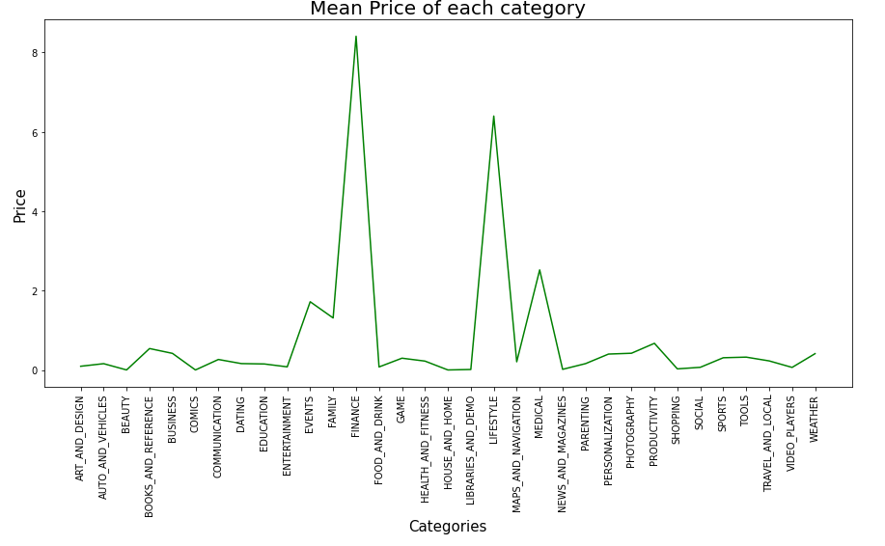
Mean Price vs Category
Highest Mean price is for FINANCE category and after that LIFESTYLE category.

Slide 9
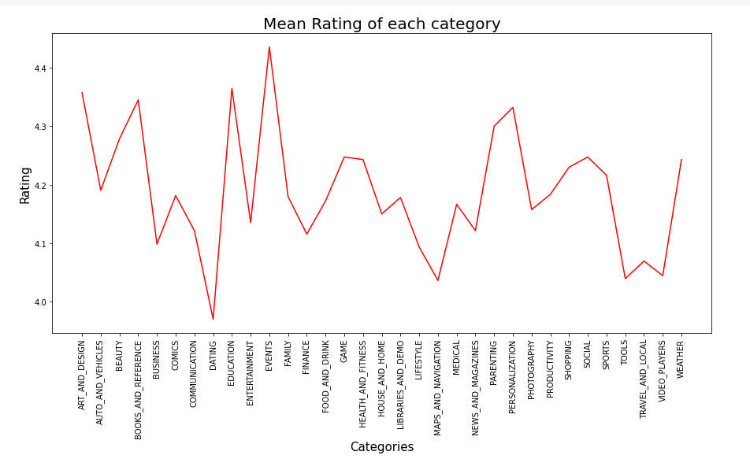
Mean Rating of each Category
Highest Rating is for EVENTS category and Lowest rating for DATING category.

Slide 10
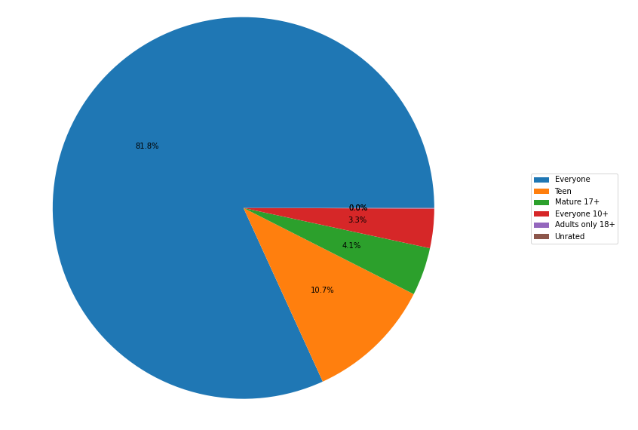
Content Ratings
From the above plot we can see that Everyone category having majority of apps count.
A majority of the apps (81.80%) in the play store are can be used by everyone. The remaining apps have various age restrictions to use it.

Slide 11
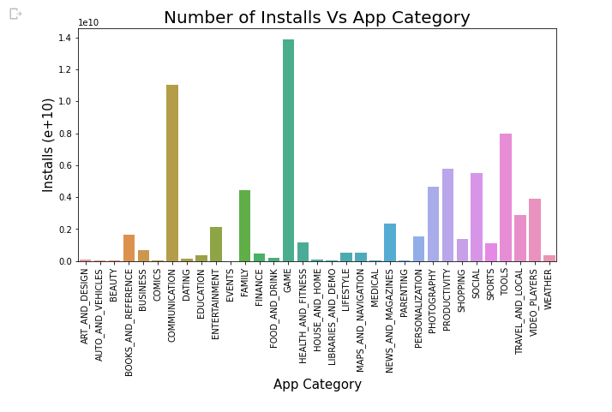
Category wise Installs of apps
Gaming have maximum number of installed app.
On second Position communication have maximum number of apps installed.

Slide 12
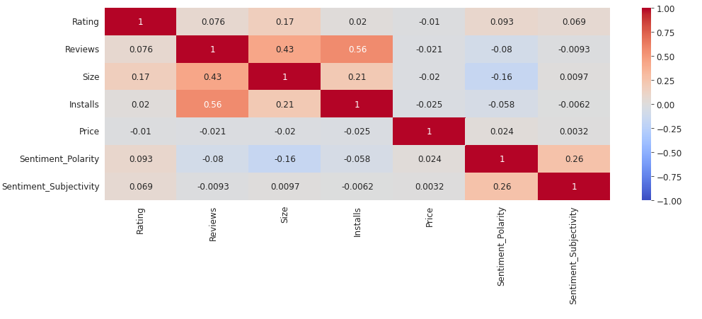
Co-Relation in Merged Dataset.
In this correlation matrix, There is not a significant relationship between Rating, Reviews, Size and Installs with respect to the Sentiment polarity and Sentiment subjectivity.

Slide 13
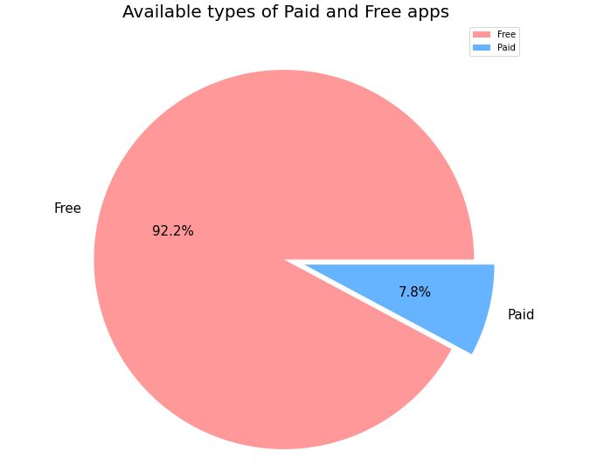
Distribution of Free and Paid apps
We Observed that 92.2% of Apps are free and only 7.8% of Apps are paid in Play store.

Slide 14
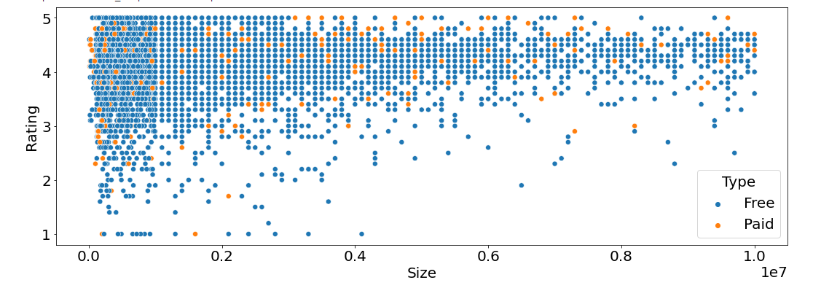
Relation between Rating, Size and Type of app
From this scatter plot, we can imply that majority of the free apps are small in size and having high rating. While for paid apps, we have quite equal distribution in term on size and rating.

Slide 15
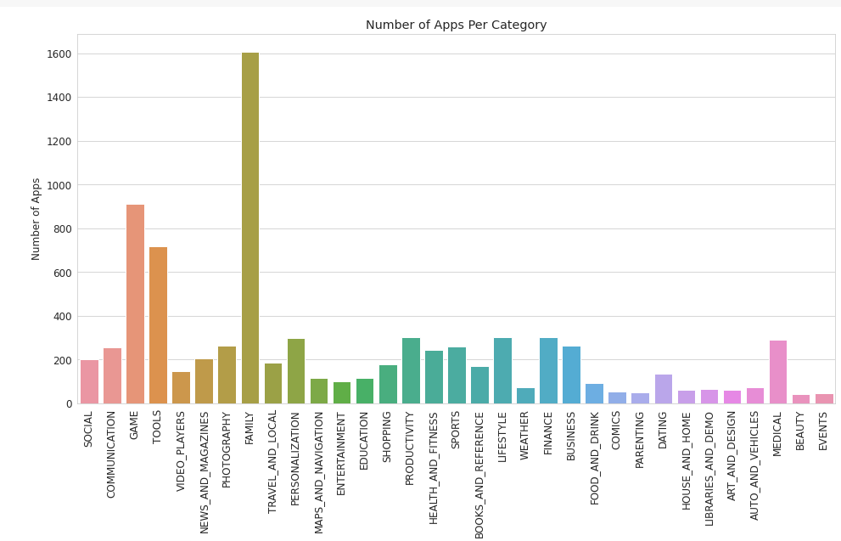
Number of apps in Category
Maximum number of apps present in 'FAMILY' category then 'GAME' category and then 'TOOLS'

Slide 16
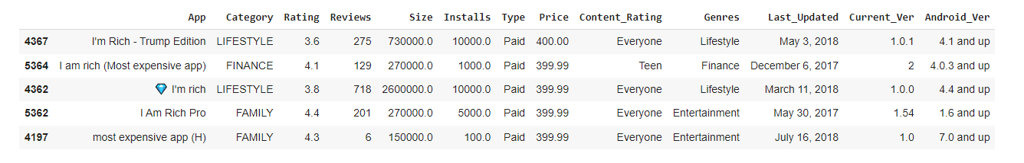
Top 5 Expensive apps
From above data we can conclude that-
The top 5 most expensive apps in the store are I'm Rich - Trump Edition, I am rich (Most expensive app), 💎 I'm rich, I Am Rich Pro, most expensive app (H).

Slide 17
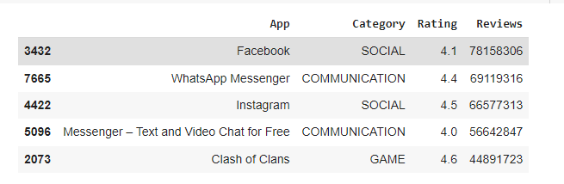
Top 5 Reviewed Apps
From the above data we can conclude that-
The 5 apps that have the most number of total reviews are Facebook, WhatsApp Messenger, Instagram, Messenger – Text and Video Chat for Free, Clash of Clans.

Slide 18
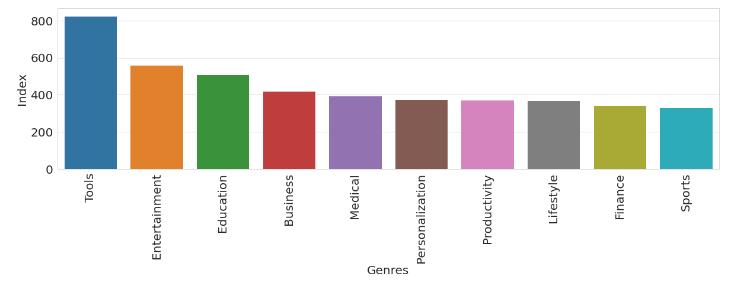
Top 10 Genres of App
Top three Genres are Tools, Entertainment & Education .

Slide 19
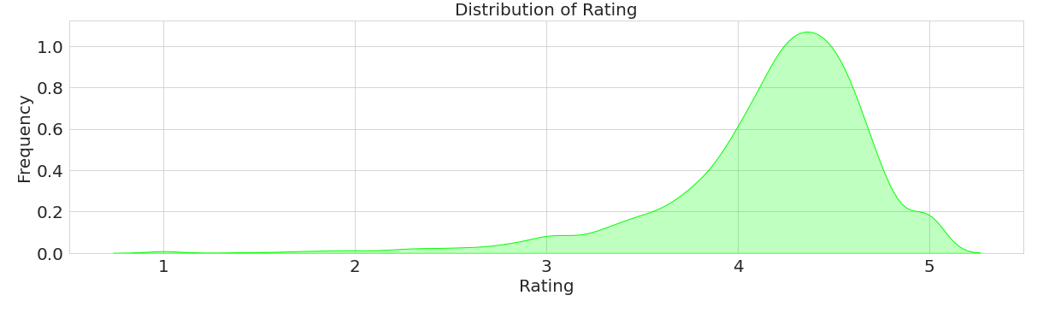
Distribution of Rating
From this distribution plotting, it implies that most of the apps in the Play Store are having rating higher than 4 or in the range of 4 to 4.7

Slide 20
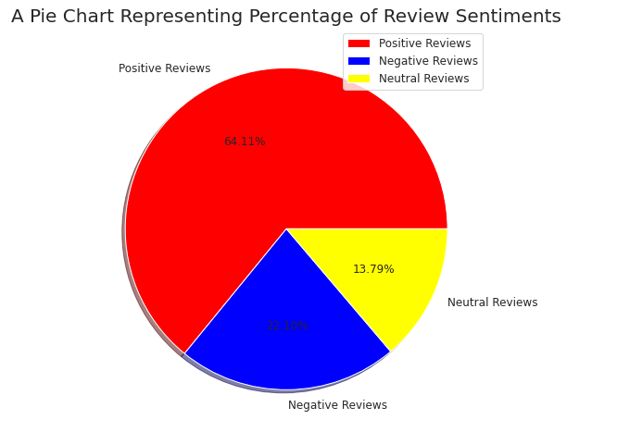
User Sentiment Analysis
From Sentiment column, 64% are Positive, 22% are Negative and 14% are Neutral Reviews.
Positive Sentiment have larger percentage, it has 3 times more than negative sentiment.

Slide 21

Challenges
Computation time.
Reading the dataset and comprehending the problem statement. Our major challenge was data cleaning.
Also dataset contains duplicate data and irrelevant data, need to clear that first was also problematic.

Slide 22
Conclusion
Rating is very important factor for installation of apps as user mostly like to watch rating before using app, so developer should also work on updating their content as per the ratings.
From all above we analyze rating and installation are related, so owners should encourage to write review of their app.
Gaming have maximum number of installed app so anyone want to become developer can join this category.
App category like events and beauty have not much reach, so one can also keep this consideration.
Most of the apps are downloaded by teens, so users of other age category, must also be encouraged to install the apps.

Slide 23
Conclusion
Maximum number of apps present in FAMILY category then GAME category and then TOOLS
Highest Mean price is for FINANCE category and after that LIFESTYLE category.
Highest Rating is for EVENTS category and Lowest rating for DATING category.
81.8% app can use every age group person.
Adults only 18+ and unrated have very less number of apps.
Gaming have maximum number of installed app.
Around 92.2% app are freely available on play store.
4.3 to 4.5 have maximum average rating on play store.
Positive Sentiment have larger percentage, it has 3 times more than negative sentiment.

Slide 24


